Slide 1
Moulded by the darkness: Grokking the TypeScript type system
Ivan Towlson
Microsoft

Slide 2
JavaScript The universal runtime

Slide 3
JavaScript The language for the universal runtime

Slide 4
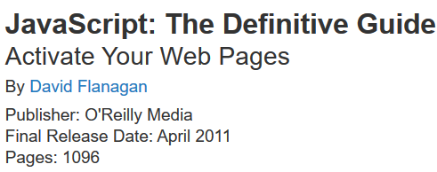
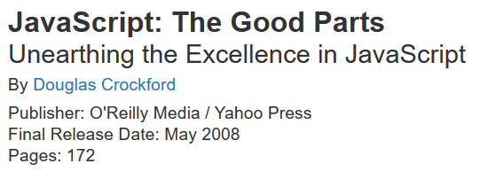
JavaScript The universally hated language for the universal runtime
Includes the appendix about the bad parts

Slide 5
JavaScript The assembly language for the universal runtime

Slide 6
ClojureScript
php.js
Script#
Fable
Java GWT
Scala.js
CoffeeScript
PureScript
JavaScript
Browser
Node.js
etc.

Slide 7
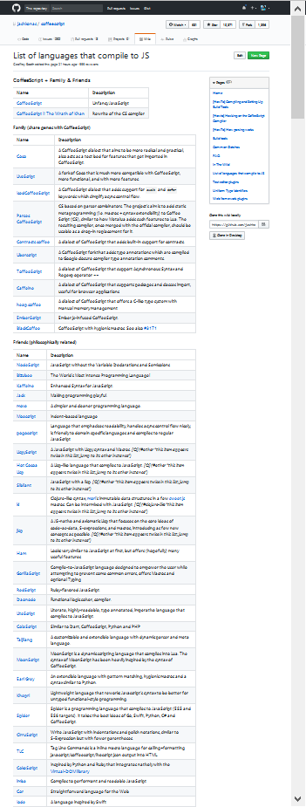
https://github.com/jashkenas/coffeescript/wiki/list-of-languages-that-compile-to-js
Screenshot at 30%

Slide 8
JavaScript The language for the universal runtime

Slide 9
TypeScript The language for the universal runtime

Slide 10
TypeScript The language for the universal runtime …with benefits

Slide 11

Oh, you think darkness is your ally. But you merely adopted the dark; I was born in it, moulded by it.
Image: http://collider.com/tom-hardy-the-dark-knight-rises-interview/

Slide 12
What do we talk about when we talk about types?

Slide 13
Simple type safety And how to defeat it

Slide 14
Tuples

Slide 15
Object types

Slide 16
Interface types

Slide 17
Class types

Slide 18
Function types

Slide 19
Intersection and union types

Slide 20
Intersection and union types
Swimmer
swim()
eat()
waddle()
Waddler
Swimmer & Waddler

Slide 21
Intersection and union types
Swimmer
swim()
eat()
waddle()
Waddler
Swimmer | Waddler

Slide 22
Index types and type mapping Reflection made safeish

Slide 23
Types as shapes Structural subtyping

Slide 24
Thanks!
Ivan Towlson
Microsoft
https://github.com/itowlson/typed-darkness
http://twitter.com/ppog_penguin
http://hestia.typepad.com/flatlander
itowlson@microsoft.com
ivan@hestia.cc

